Slide 1
Selenium + Java Training
Trainer – Nikunj Shah

Slide 2
Test Driven Development
TDD is an iterative development process. Each iteration starts with a set of tests written for a new piece of functionality.
These tests are supposed to fail during the start of iteration as there will be no application code corresponding to the tests.
In the next phase of the iteration, Application code is written with an intention to pass all the tests written earlier in the iteration. Once the application code is ready tests are run.
Any failures in the test run are marked and more Application code is written/re-factored to make these tests pass. Once application code is added/re-factored the tests are run again.
This cycle keeps on happening until all the tests pass. Once all the tests pass we can be sure that all the features for which tests were written have been developed.

Slide 3
Drawbacks of TDD
Developer can consider it as a waste of time
The test can be targeted on verification of classes and methods and not on what the code really should do
Test become part of the maintenance overhead of a project
Rewrite the test when requirements change

Slide 4
Behavior Driven Development
Shifting from thinking in “tests” to thinking in “behavior”
Collaboration between Business stakeholders, Business Analysts, QA Team and developers
Ubiquitous language, it is easy to describe
Driven by Business Value
Extends Test-Driven Development (TDD) by utilizing natural language that non-technical stakeholders can understand
BDD frameworks such as Cucumber or JBehave are an enabler, acting a “bridge” between Business & Technical Language

Slide 5
Why BDD
Let’s assume there is a requirement from a client for an E-Commerce website to increase the sales of the product with implementing some new features on the website.
The original idea is awesome. But the only challenge here is that the person who is developing the idea is not the same person who has this idea
The only challenge of the development team is to convert the client idea into something that actually delivers the benefits to client.
Now the idea needs to be communicated and has to travel from Business Owners(Client) to the development teams or many other people.
That is why BDD comes in picture

Slide 6
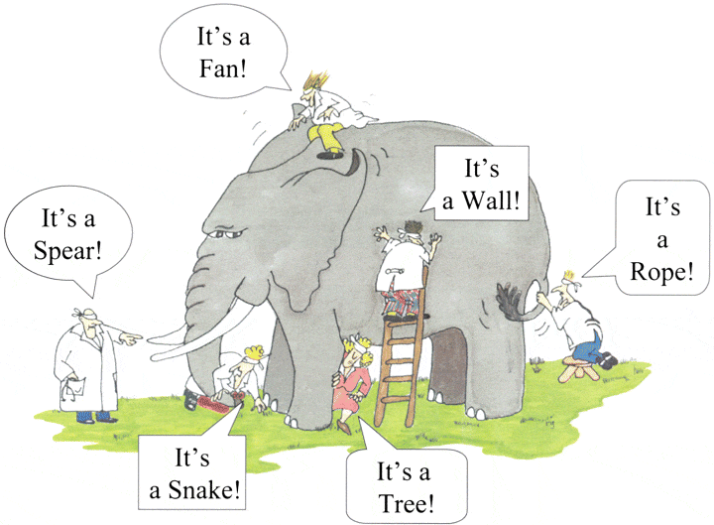
Why BDD

Slide 7
How to Achieve BDD?
Gherkin BDD Language
Cucumber BDD Framework
SpecFlow BDD Framework

Slide 8
Gherkin BDD Language
Clients, Developers, Testers, Business analysts and the Managerial team. Let’s start by talking about usual problems of a development project first and then we will move to a solution, while doing so we will come across the need for a common language.
For that Gherkin is a structured language it follows some syntax which allow us to write the requirements in plain English language
The test is written in plain English which is common to all the domains of your project team.
This test is structured that makes it capable of being read in an automated way. There by creating automation tests at the same time while describing the scenario

Slide 9
Non Gherkin Example
3. Functional Requirements
3.1 Search Functionality
3.1.1 User should be able to search for a product
3.1.2 Only the products related to search string should be displayed.

Slide 10
Gherkin Example
Feature: Search feature for users
This feature is very important because it will allow users to filter products
Scenario: When a user searches, without spelling mistake, for a product name present in inventory. All the products with similar name should be displayed
Given User is on the main page of www.xyz.com
When User searches for laptops
Then search page should be updated with the lists of laptops

Slide 11
Tools to Write Gherkin
Tidy Gherkin
https://chrome.google.com/webstore/detail/tidy-gherkin/nobemmencanophcnicjhfhnjiimegjeo?hl=en-GB

Slide 12
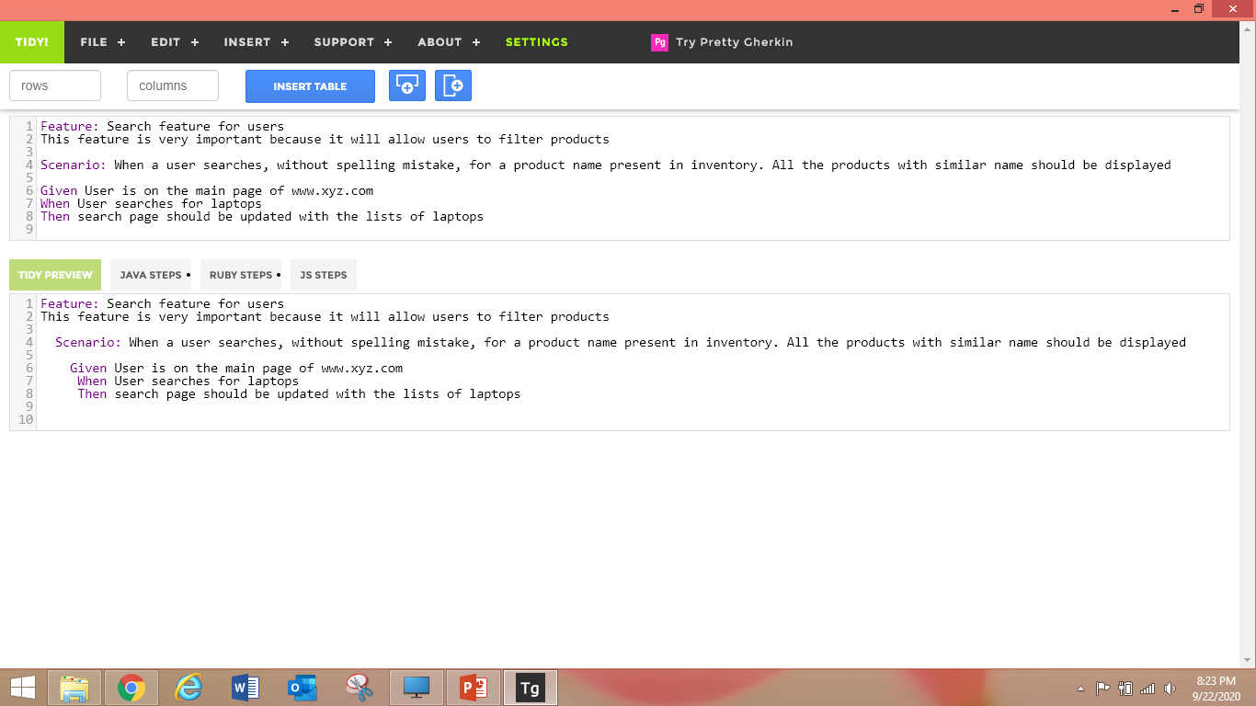
TIDY Tool

Slide 13
A Simple Feature File
Feature: Google Searching
As a web surfer, I want to search Google, so that I can learn new things.
Scenario: Simple Google search
Given a web browser is on the Google page
When the search phrase "panda" is entered
Then results for "panda" are shown

Slide 14
A Simple Feature File with Additional Steps
Feature: Google Searching
As a web surfer, I want to search Google, so that I can learn new things.
Scenario: Simple Google search
Given a web browser is on the Google page
When the search phrase "panda" is entered
Then results for "panda" are shown
And the related results include "Panda Express"
But the related results do not include "pandemonium"

Slide 15
The Background Section
Feature: Google Searching
As a web surfer, I want to search Google, so that I can learn new things.
Background:
Given a web browser is on the Google page
Scenario: Simple Google search for pandas
When the search phrase "panda" is entered
Then results for "panda" are shown
Scenario: Simple Google search for elephants
When the search phrase "elephant" is entered
Then results for "elephant" are shown

Slide 16
Scenario Outlines
Feature: Google Searching
As a web surfer, I want to search Google, so that I can learn new things.
Scenario Outline: Simple Google searches
Given a web browser is on the Google page
When the search phrase "<phrase>" is entered
Then results for "<phrase>" are shown
And the related results include "<related>"
Examples:
| phrase | related |
| panda | Panda Express |
| elephant | Elephant Man |

Slide 17
Scenario Outlines
Feature: Google Searching
As a web surfer, I want to search Google, so that I can learn new things.
Scenario Outline: Simple Google searches
Given a web browser is on the Google page
When the search phrase "<phrase>" is entered
Then results for "<phrase>" are shown
And the related results include "<related>"
Examples:
| phrase | related |
| panda | Panda Express |
| elephant | Elephant Man |

Slide 18
What is Cucumber?
Cucumber is a testing framework designed to support Behavior Driven Development (BDD) framework. It defines application behavior using simple English text, defined by a language called Gherkin.
Cucumber allows automation functional validation that is easily read and understood. Cucumber was initially implemented in Ruby and then extended to Java framework. Both the tools support native JUnit.
With cucumber by the time the code is ready, test scripts are ready too. The code has to pass the test scripts defined in BDD.

Slide 19
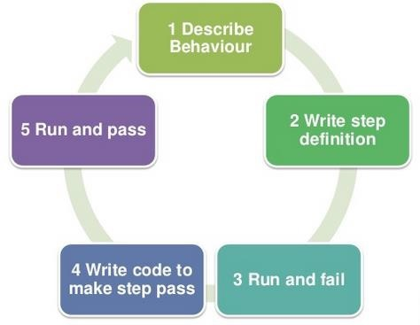
How it works?

Slide 20
Advantages
Cucumber supports different languages like Java.net and Ruby.
It acts as a bridge between the business and technical language. We can accomplish this by creating a test case in plain English text.
It allows the test script to be written without knowledge of any code, it allows the involvement of non-programmers as well.
It serves the purpose of end-to-end test framework unlike other tools.
Due to simple test script architecture, Cucumber provides code reusability.

Slide 21
How to implement?
Download the Eclipse Cucumber plugin
Add below dependencies in POM.xml
Maven Path : https://mvnrepository.com/artifact/io.cucumber
cucumber-java
cucumber-junit
cucumber-java8
cucumber-jvm
cucumber-gherkin

Slide 22
Cucumber Tags
Scenario Tags
Will be used to run scenarios
Feature Tags
Will be used to run entire feature

Slide 23
How to Run the Test?
Using the junit Runner class
@RunWith(Cucumber.class) @CucumberOptions( monochrome=true, plugin = {"pretty", "html:target/cucumber-html"}, features = "src/test/java/validations", tags = {"@Sanity"}, glue = { "validations" } )

Slide 24
How to Run the Test?
Using the command line
Commands :
mvn test
mvn test -Dcucumber.options="--tag @tag1"

